Slide 1
Project 3:
Building a Secure Monitoring Environment
By: TaSheria Walls, Gertrise Thomas, Patrick Schultz, Shantel Varner, Katie Prude-Turner & Leondra Rascoe

Slide 2
Table of Contents
This document contains the following resources:
Monitoring Environment
Attack Analysis
Project Summary & Future Mitigations

Slide 3
Monitoring Environment
‹#›

Slide 4
Scenario
Our analyst team has been tasked with monitoring potential cyber threat against Virtual Space Industries' (VSI) due to recent intel that a competitor, JobeCorp, may attempt to launch cyberattacks to disrupt VSI’s operations.
To mitigate these risks, we are utilizing Splunk to actively monitor and analyze security events across two key systems:
Apache Web Server – Hosts VSI’s administrative webpage, a critical access point for system management.
Windows Operating System – Supports essential back-end operations vital to VSI’s business continuity.
We have been provided with historical log data to help establish security baselines, identify anomalies, and develop reports, alerts, and dashboards.
This initiative aims to strengthen VSI’s cybersecurity posture and safeguard its digital assets against emerging threats.

Slide 5
Splunk Security Essentials
‹#›

Slide 6

Splunk Security Essentials
Splunk Security Essentials (SSE) is a free add-on that enhances security operations by providing prebuilt detection rules, best practices, and detailed use case guidance. SSE integrates seamlessly with Splunk's analytics engine, delivering out-of-the-box security content mapped to industry frameworks such as MITRE ATT&CK®, NIST, and CIS. It acts as a force multiplier for security teams, enabling quick deployment of detection strategies, improving threat visibility, and supporting data-driven security workflows.
Key Features:
Prebuilt Security Content: Access over 600+ detection and response use cases, mapped to security frameworks for efficient threat identification.
Guided Implementation: Follow step-by-step walkthroughs to deploy security detections, complete with sample data and validation tools.
MITRE ATT&CK® Integration: Visualize security detections within the ATT&CK framework, providing a structured and strategic approach to threat detection.
Anomaly Detection & Risk-Based Alerting: Detect deviations from normal behavior and prioritize alerts using risk scoring to focus on the most critical threats.
Cost-Effective Solution: Available as a free app on Splunkbase, offering powerful security enhancements without additional licensing costs.

Slide 7
Splunk Security Essentials Scenario
Scenario: Protecting VSI from Competitor Cyberattacks with Splunk Security Essentials
Company:
Virtual Space Industries (VSI) is a leader in virtual-reality program design.
Received intelligence that competitor JobeCorp may attempt cyberattacks to disrupt operations.
Leadership is concerned about espionage, DDoS attacks, and insider threats, but lacks visibility into potential threats.
Solution:
VSI’s Security Operations Center (SOC) deploys Splunk Security Essentials (SSE) to enhance security defenses.
Prebuilt Threat Detections:
Utilize ready-to-use security detections for:
DDoS attack monitoring
Unusual login attempts
Unauthorized data access tracking
MITRE ATT&CK® Mapping:
Identify and address security gaps by mapping them to JobeCorp’s suspected attack techniques.
Implement enhanced intrusion detection rules to counter potential threats.
Risk-Based Alerting:
Automatically trigger alerts for anomalous employee activity, such as:
Unauthorized access to proprietary VR design files
Suspicious login patterns
Security Posture Dashboard:
Monitor ongoing threats and track security improvements.
Maintain proactive defenses against corporate espionage.
Notes:
DDos (Distributed Denial-of-Service)

Slide 8
Splunk Security Essentials Scenario, Cont.
Outcome:
Prevented Data Theft: VSI detects and stops an unauthorized access attempt before critical VR designs are stolen.
Improved Threat Detection: VSI gains full visibility into DDoS attempts and login anomalies, blocking attacks before they escalate.
Strengthened Competitive Security: By leveraging Splunk Security Essentials, VSI stays ahead of JobeCorp’s cyber threats, ensuring business continuity.
Using Splunk Security Essentials, VSI proactively defends against cyber threats, prevents business disruption and protects its intellectual property—all at no extra cost.

Slide 9
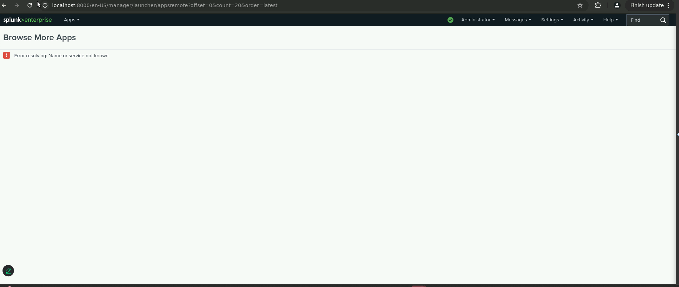
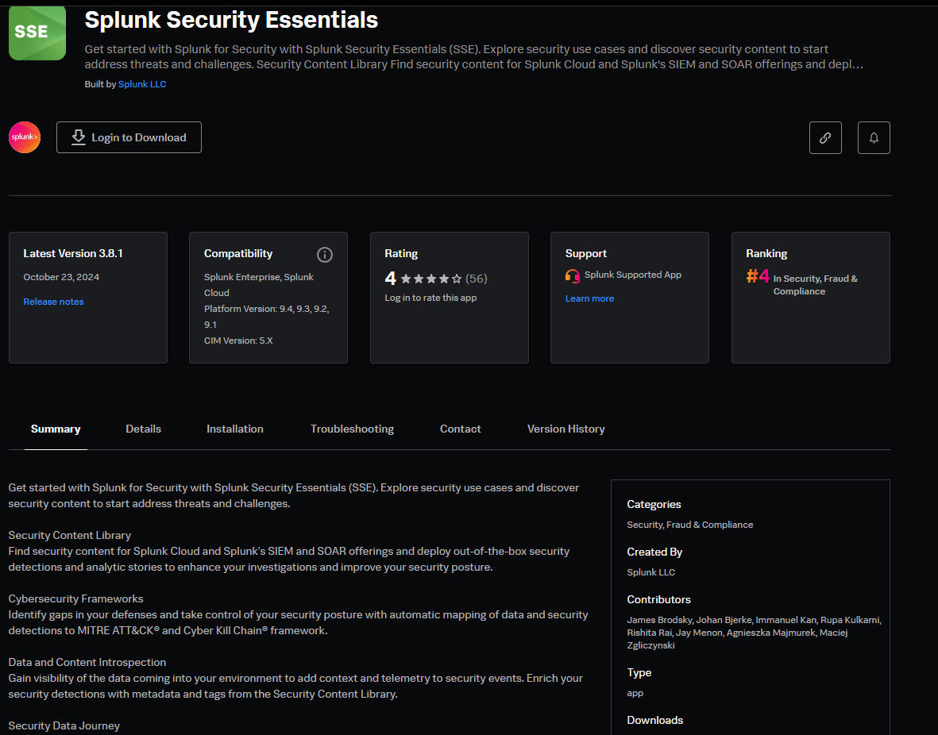
Splunk Security Essentials

Slide 10
Logs Analyzed
1
Windows Logs Apache Logs
2
This server contains intellectual property of VSI’s next-generation virtual-reality programs.
■Windows Logs
■Windows Attack Logs
This server is used for VSI’s main public-facing website, vsi-company.com.
■Apache Logs
■Apache Attack Logs
Logs Analyzed

Slide 11
Windows Logs
‹#›

Slide 12
Reports — Windows
Designed the following reports:
Report Name | Report Description
Windows_Server_logs_Signatures_and Signature IDs | Log showcasing the cumulative count of events executed for each signature ID.
Windows_Server_logs_Severity_levels_counts_and percentages | Log presenting the percentage distribution of events across various severity levels.
Windows_server_logs_Success_and_Failure | Log presenting the total count, percentage distribution, and detailed events of successful and failed account activities.

Slide 13
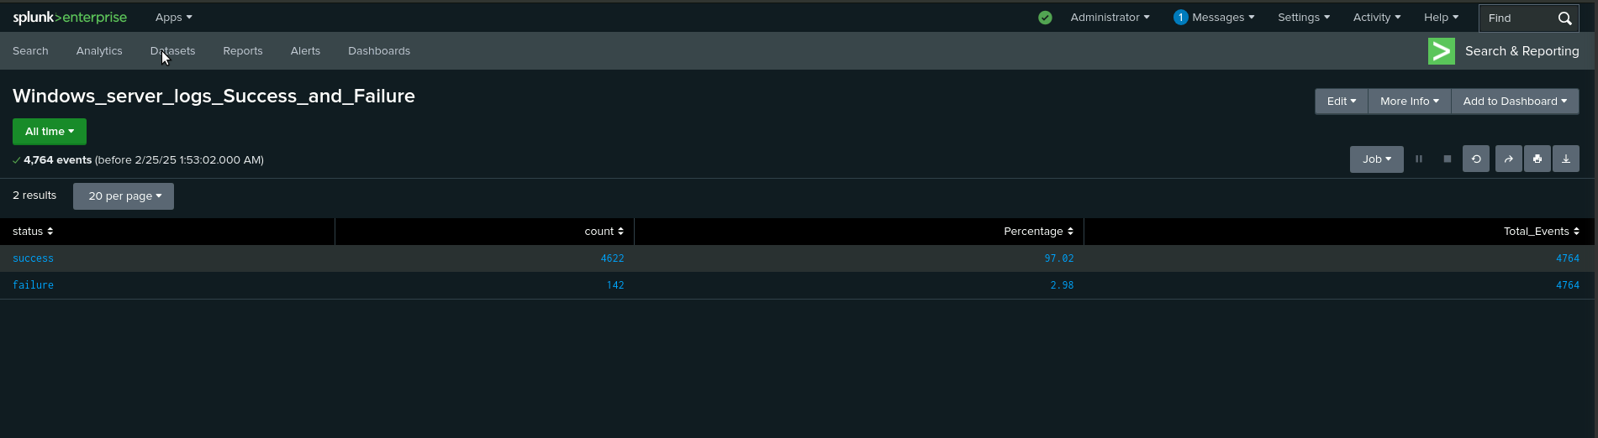
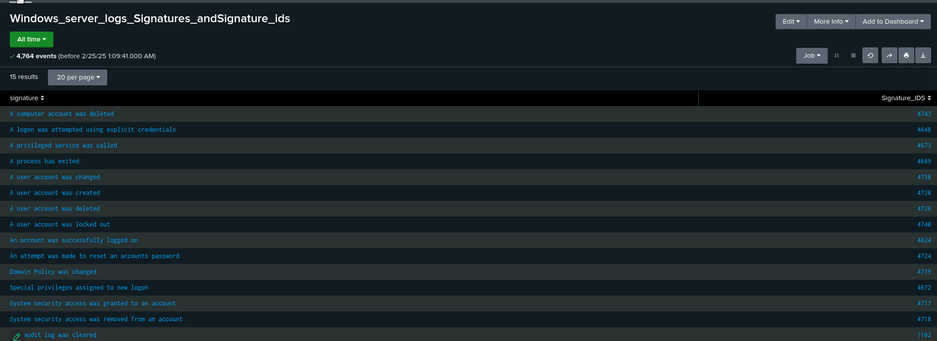
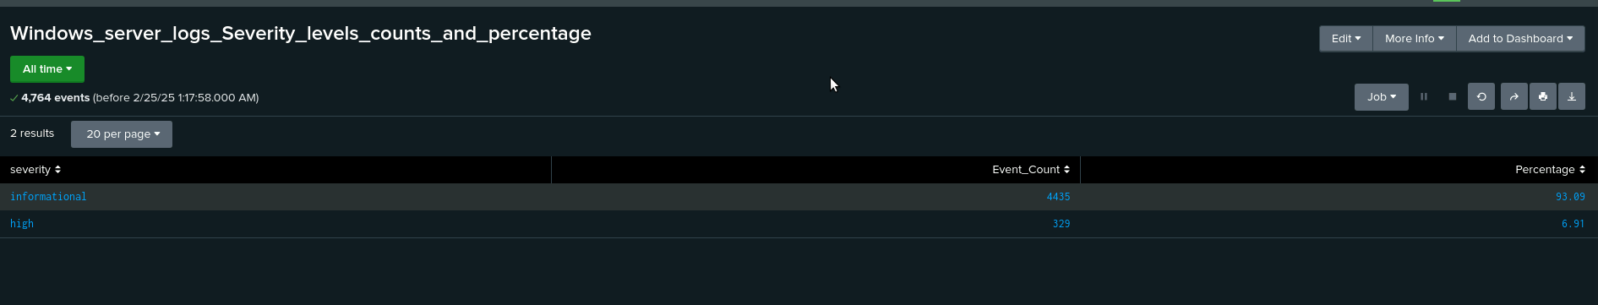
Images of Reports — Windows

Slide 14
Alerts — Windows
Designed the following alerts:
Alert Name | Alert Description | Alert Baseline | Alert Threshold
Windows Server Logs Failed Windows Activity | Alert log capturing and displaying login failure events. | 5 | 7
JUSTIFICATION: We set the baseline at five, as it represents the average number of alerts, with the highest counts reaching 9 and 10. We set the threshold at seven, as it served as a clear indicator of an attack.

Slide 15
Alerts — Windows
Designed the following alerts:
Alert Name | Alert Description | Alert Baseline | Alert Threshold
Windows Server Logs-Successful Log On | Alert log capturing and displaying successful login events. | 13 | 15
JUSTIFICATION: We set the baseline at 13, as it represents the average number of alerts for successful login events. Similarly, we chose the alert threshold at 15 as it signifies a potential successful log in attack.

Slide 16
Alerts — Windows
Designed the following alerts:
Alert Name | Alert Description | Alert Baseline | Alert Threshold
Windows Servers Logs - Deleted Accounts | Alert log capturing and displaying successful account deletions. | 10 | 13
JUSTIFICATION: The baseline for deleted accounts was set at 10 as it was the average number of alerts for deleted accounts. Between 9AM and 3PM, account deletions peaked at 22, marking the highest activity during this period.

Slide 17
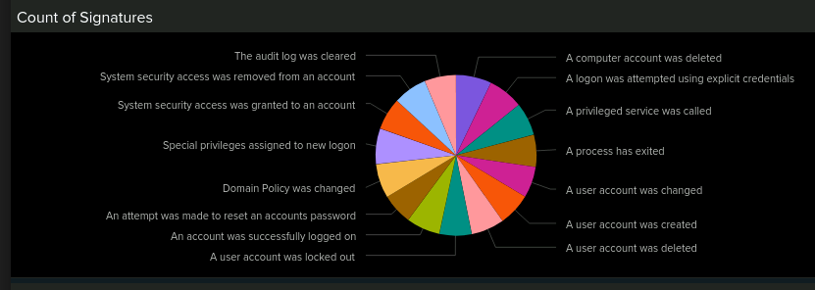
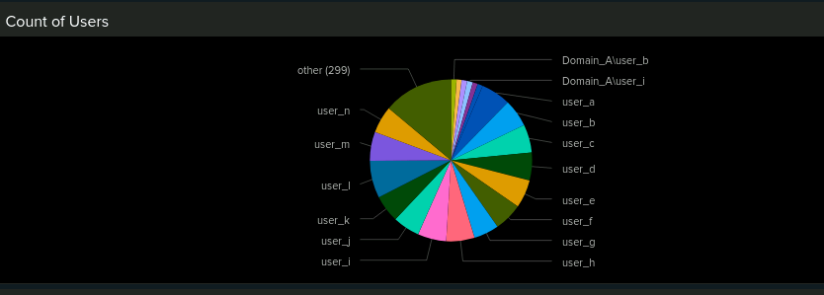
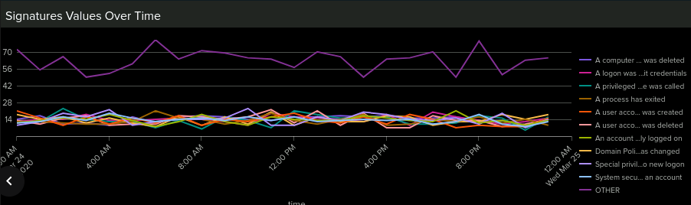
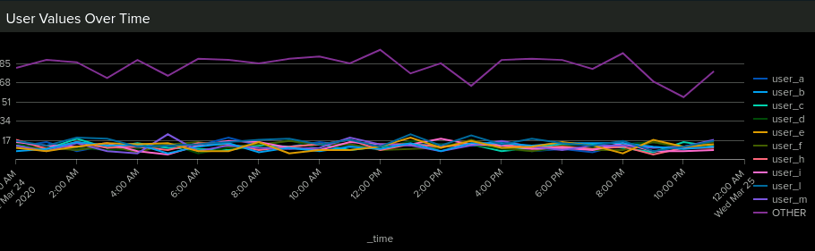
Dashboards—Windows

Slide 18
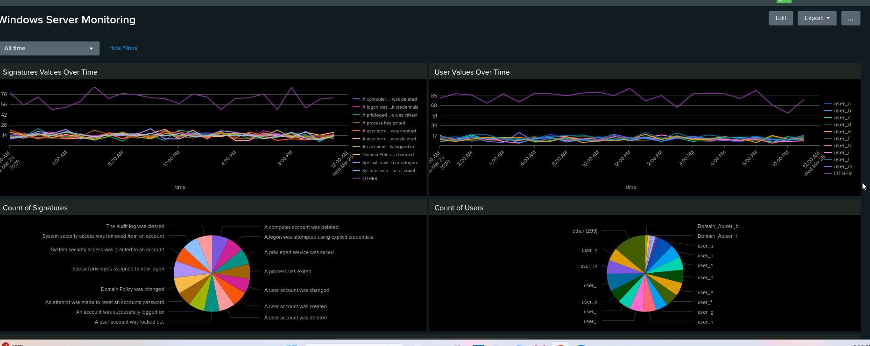
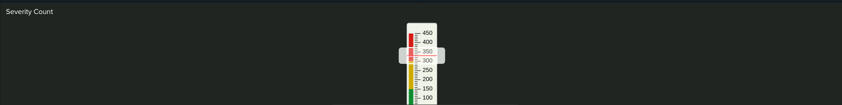
Dashboards — Windows

Slide 19
Apache Logs
‹#›

Slide 20
Reports — Apache
Designed the following reports:
Report Name | Report Description
VSI TOP HTTP Methods | HTTP activity being requested against VSI’s web server
VSI Top Domains | Analyzes the different referrer domains.
VSI HTTP Response Codes | Provides insight into any suspicious levels of HTTP responses

Slide 21
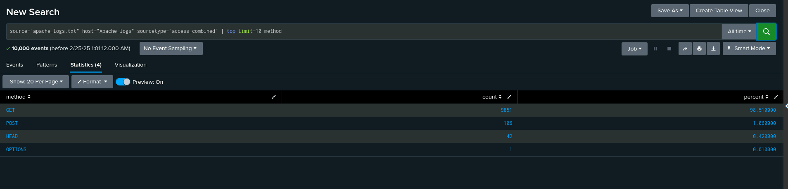
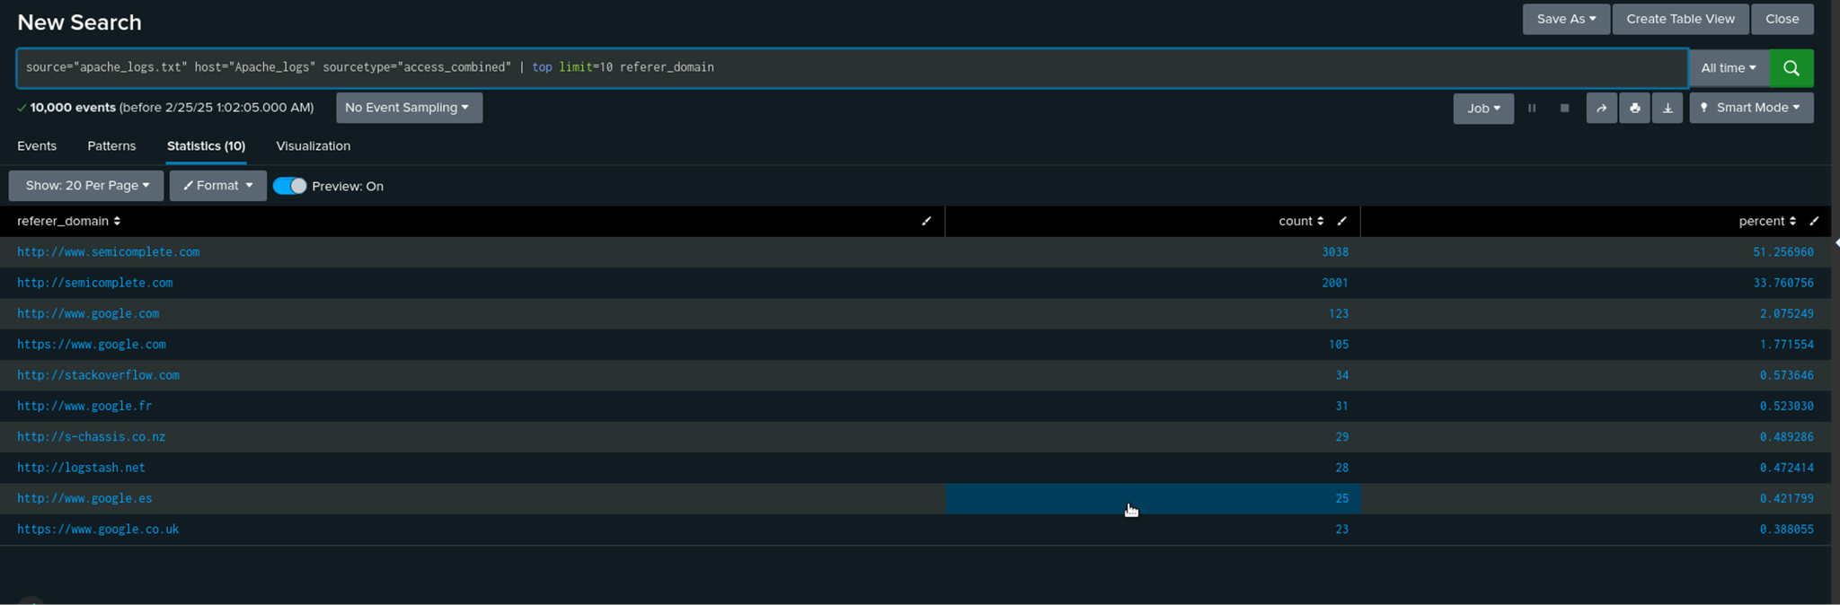
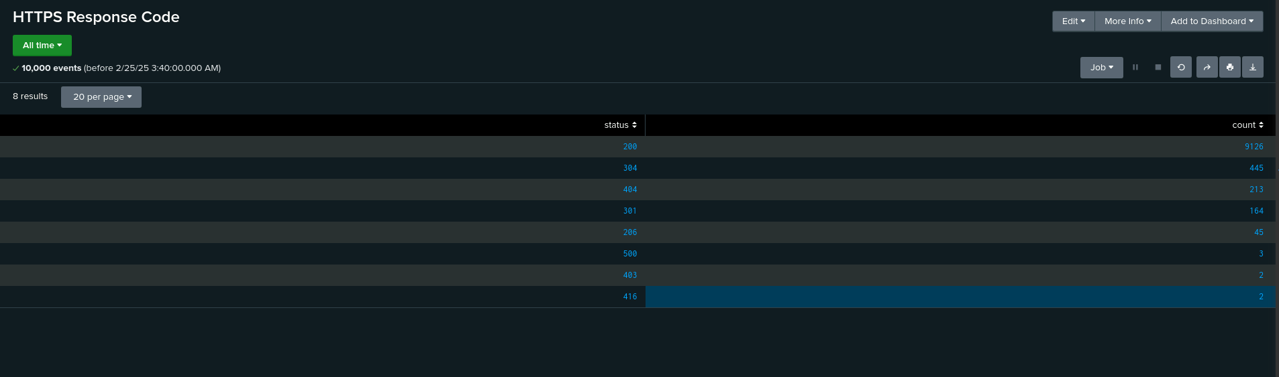
Images of Reports — Apache
VSI Top HTTP Method
HTTP Response Code
Top 10 Domains
Top 10 Domains Report

Slide 22
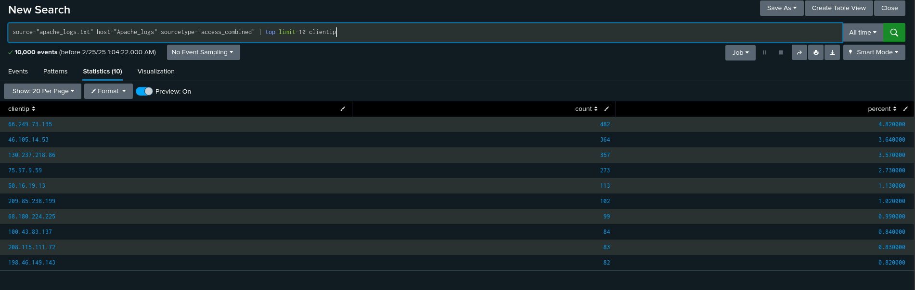
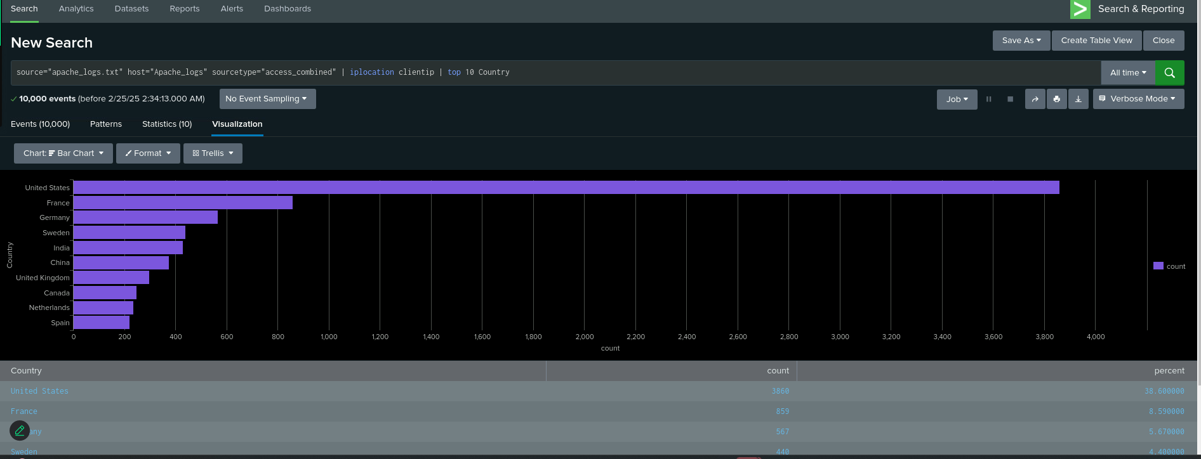
Images of Reports — Apache
Top 10 Client IP
Top 10 Country AWSM Dashboard
Notes:
AWSM (Apache Web Server Monitoring)

Slide 23
Alerts — Apache
Designed the following alerts:
Alert Name | Alert Description | Alert Baseline | Alert Threshold
VSI IP Outside of US | Activity from any country besides the United States; alert should trigger an email to SOC@VSI-company.com when the threshold has been reached | 120 | 125
"The 'VSI IP Outside of US' alert is based on analyzing past log data to find the normal amount of access requests from non-U.S. IP addresses. The baseline is set at 120, representing the usual activity level. The alert threshold is slightly higher at 125 to handle occasional traffic spikes. This balance helps reduce false positives while ensuring that only truly unusual or suspicious activity triggers the alert."
Top 10 Domains Report

Slide 24
Alerts — Apache
Designed the following alerts:
Alert Name | Alert Description | Alert Baseline | Alert Threshold
VSI HTTP POST Count | Hourly count of the HTTP POST method The alert should trigger an email to SOC@VSI-company.com when the threshold has been reached | 7 | 12
"The 'VSI HTTP POST Count' alert is based on analyzing historical data to find the typical hourly number of HTTP POST requests, with an average of 7. The threshold is set at 12, allowing a buffer for normal traffic increases. This approach helps reduce false positives while ensuring that any significant deviations are flagged for review, helping to detect potentially malicious activities."

Slide 25
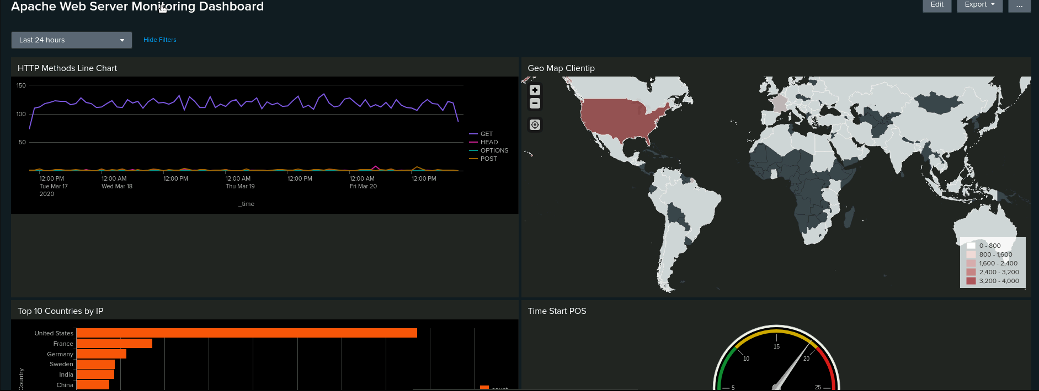
Dashboard — Apache Web Server Monitoring
Geo Map

Slide 26
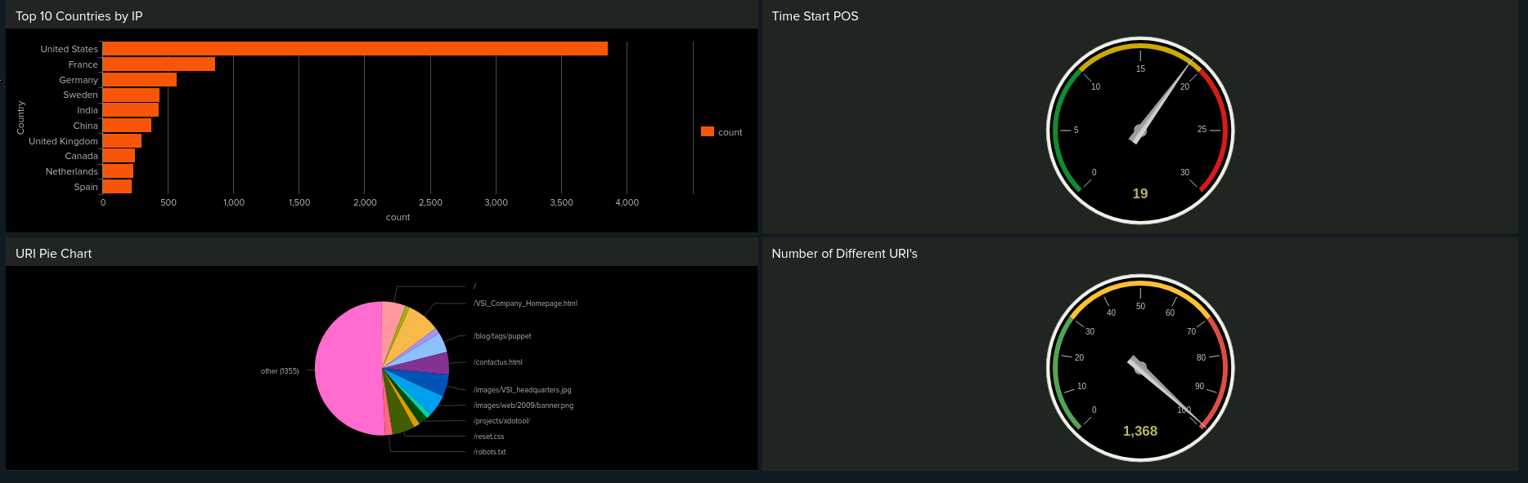
Dashboard — Apache Cont.

Slide 27
Attack Analysis
‹#›

Slide 28
Attack Summary — Windows
Our findings from analyzing the reports:
For the Windows Server Logs - Success and Failures:
The Status for success
Event Count: increased from 4622 to 5856
Percentages: increased from 97.02% to 98.44%
The status for failure
Event Count: decreased from 142 - 93
Percentage: decreased from 2.98% to 1.56%
For the Windows Server Logs - Severity levels counts and percentages:
Informational:
Event Count: decreased from 4435 - 4383
Percentages: decreased from 93.09% to 79.78%
High:
Event Count: increased from 329 to 1111
Percentages increased from 6.91% to 20.22%

Slide 29
Attack Summary — Windows
Our findings from analyzing the alerts:
While analyzing alerts via the attack logs we identified that there were issues affecting the visibility and effectiveness of security alerts.
No alerts were visible on the designated alerts page
Adjustments to scheduled alert times and expiration settings did not resolve the issue.
Potential alerts were only visible when selecting the “All Time” filter in the search page.
All alerts were set in 2020 with no new alerts being generated.
Due to the lack of properly triggered alerts, we were unable to accurately assess whether existing baselines and threshold configurations were effective.

Slide 30
Attack Summary — Windows
Our findings from analyzing the dashboards:
Analyzing the dashboards via the attack logs, we noticed changes in the percentages and values for our Severity, Signature Values and User Values over time dashboards.
We observed a striking correlation between the spike in user attack values and the surge in signature detections, both occurring simultaneously. This alignment suggests a potential connection between the two events.
Signature Value - an attempt to reset password - coincides with User K
from 8AM to 11AM the value for User spiked
Signature Value - a user account was locked - coincides with User A
from 12AM to 3AM the value for User spiked
Signature Value - an account was successfully logged into - coincides with User J
from 10AM - 1PM the value for User spiked

Slide 31
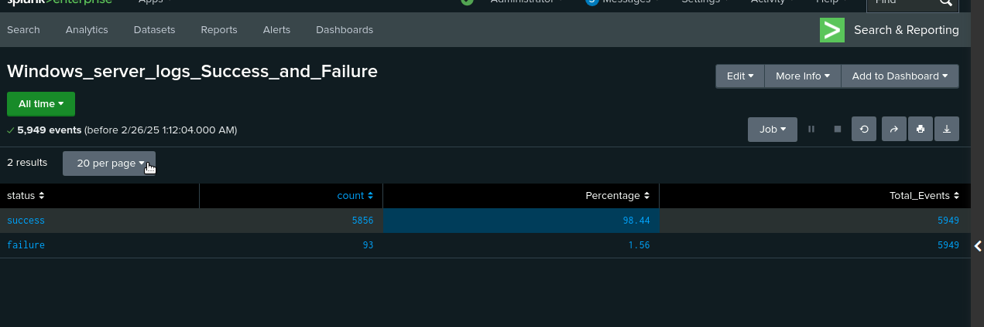
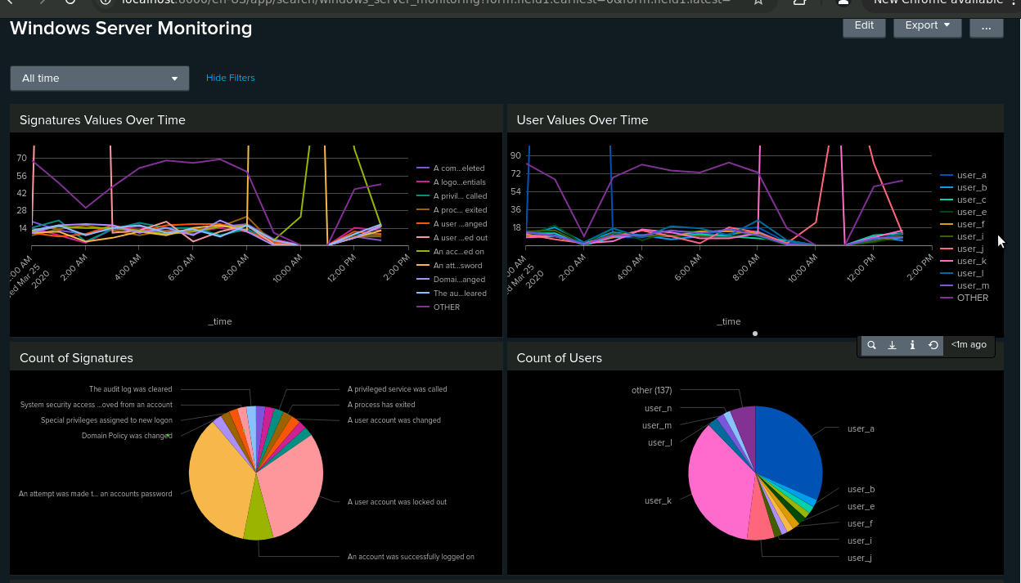
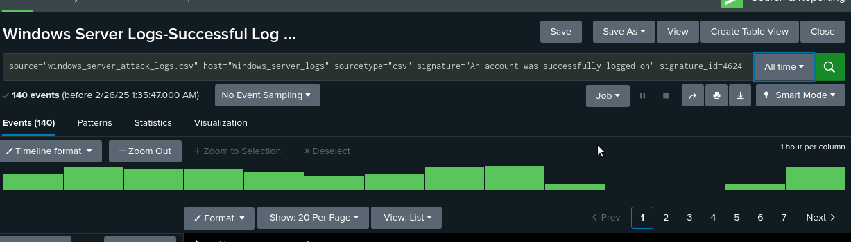
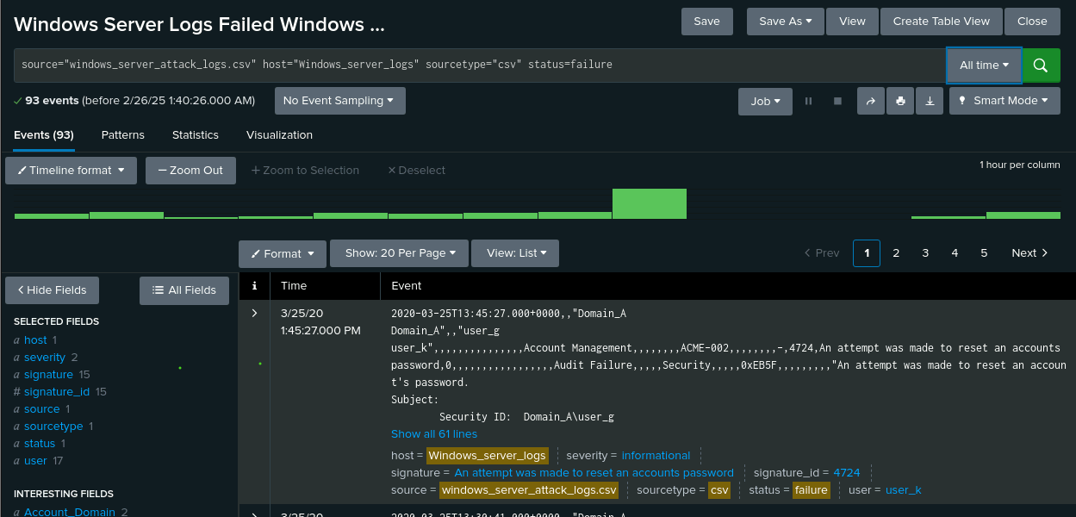
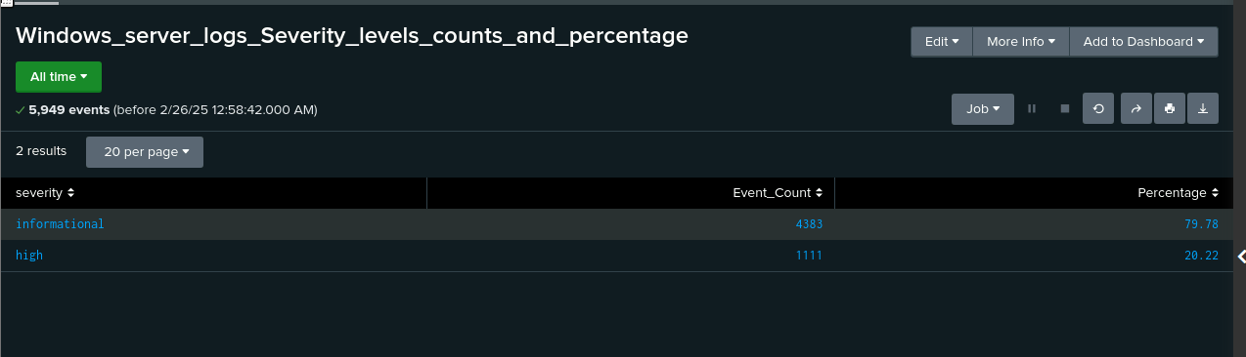
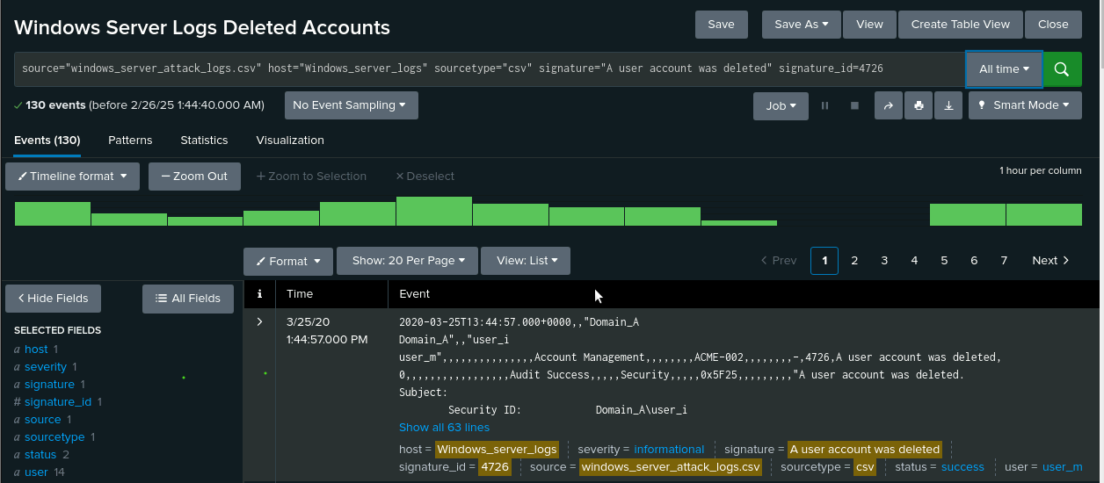
Screenshots of Attack Logs

Slide 32
Attack Summary — Apache
VSI detected suspicious changes in the HTTP method, especially with POST. The POST method is used to transmit data to the server from the HTTP client. POST had an increase of 1218.
We detected minor changes in the results. The last 5 on the domain list had a decrease in referrer domains. The HTTP response had changes in the response codes 404(Apache_logs:213,Apache_attack_logs:679 and 200(Apache_logs:9126, Apache_attack_logs:3746).
Code 404 increased to 679 counts, while 200 decreased to 3746 counts.
Notes:
Summarize your findings from your reports when analyzing the attack.

Slide 33
Attack Summary — Apache
●URL Data-Activity increased on the VSI_Account_login.php. The URL that had the most hits, was /VSI_Accont_login.php, which shows a either a brute force attack or an SQL injections attack.
● HTTP Methods-Post method was used between the dates of 18Mar2020 to 20Mar2020 with a total count of 1324.
● Cluster Map-There was suspicious activity present coming from Kiev (438 counts) and Kharkiv (432 counts).
Notes:
Summarize your findings from your alerts when analyzing the attack logs. Were the thresholds correct?

Slide 34
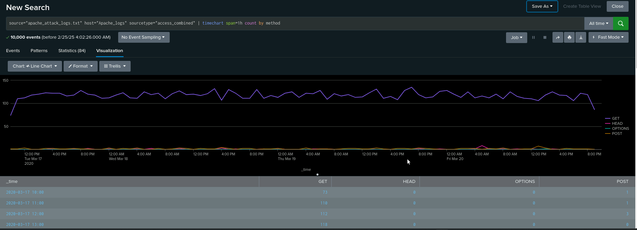
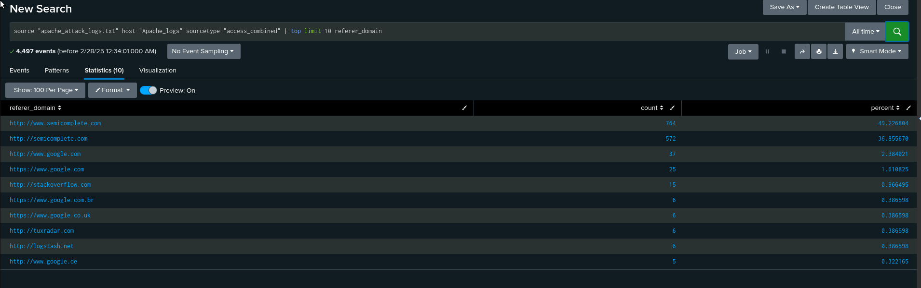
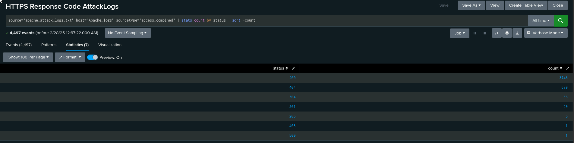
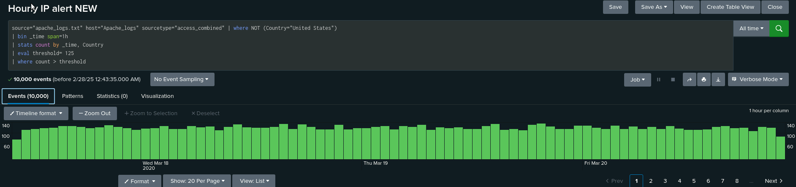
Screenshots of Attack Logs
HTTP Methods Attack Logs
Referrer Domains Attack Logs
International IP Attack Alert Log
HTTP Response Code Attack Logs

Slide 35
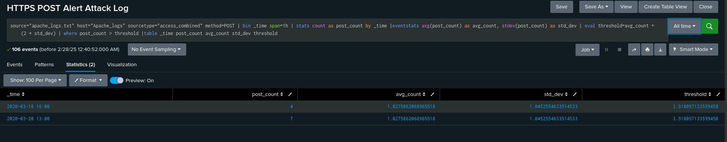
Screenshots of Attack Logs Cont.
HTTP POST Attack Alert Log

Slide 36
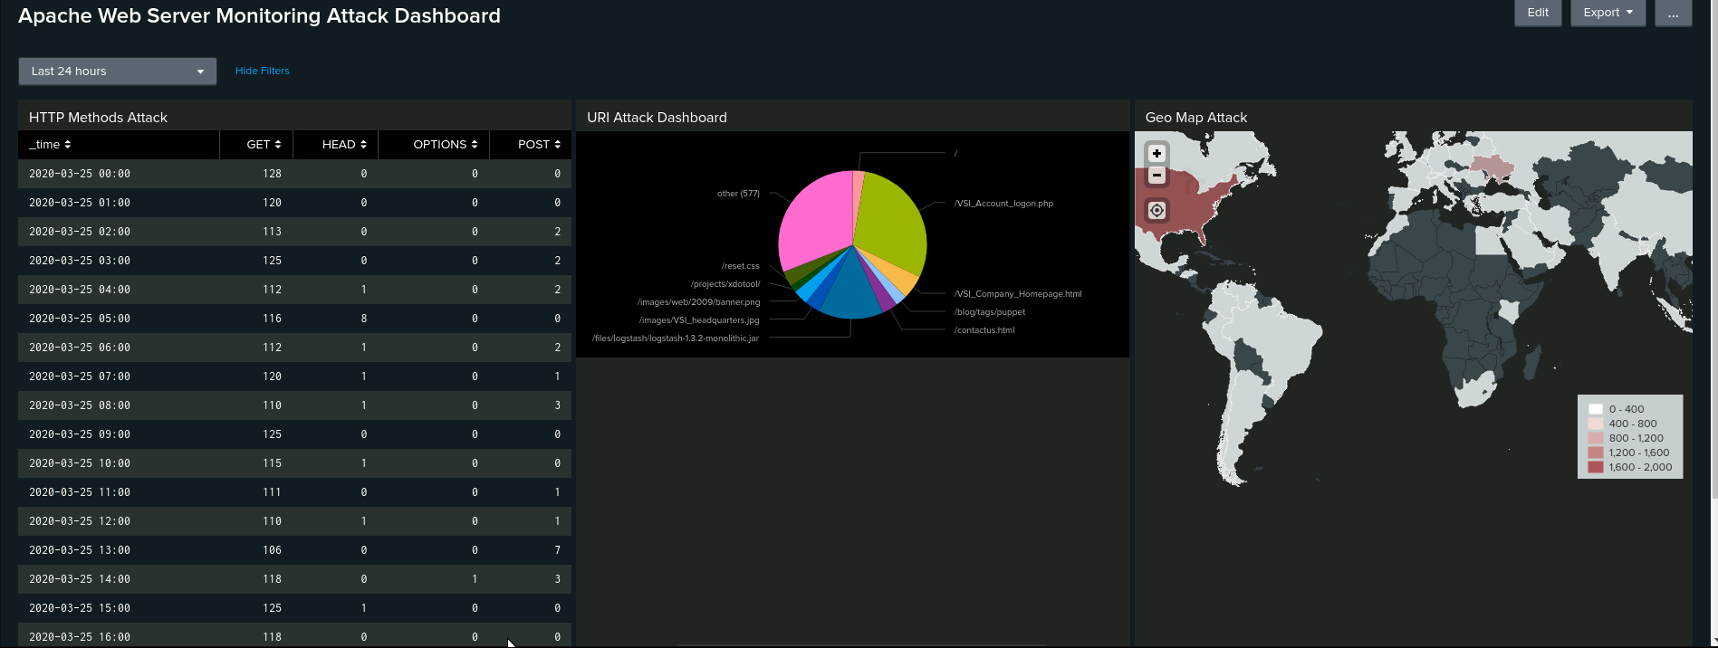
Apache Attack Dashboard

Slide 37
Summary and Future Mitigations
‹#›

Slide 38
Project 3 Summary
Following our analysis of VSI’s security logs, our team identified multiple cyberattacks targeting both the Windows operating system and Apache web server. The primary attack vector was brute-force password attempts from various regions and countries.
Proposed Mitigation Measures:
To enhance VSI’s security posture and prevent future attacks, we recommend implementing the following measures:
Account Lockout Policy – Automatically lock user accounts after three consecutive failed login attempts to prevent automated brute-force attacks.
Two-Factor Authentication (2FA) – Enforce 2FA across all critical systems to add an additional layer of security beyond traditional passwords.
By implementing these measures, VSI can significantly reduce the risk of unauthorized access and strengthen authentication security.

